Slide 1
Salesforce Knowledge Base Implementation for Enhanced Customer Service

Slide 2
Business Need for Knowledge Base
Challenges:
Customers waiting too long for resolutions.
Agents spending too much time searching for solutions.
Customers relying heavily on customer support.
Solution:
Implement Salesforce Knowledge Base to provide agents and customers with instant access to helpful articles.

Slide 3
How Knowledge Base Works
Articles are created based on common issues and solutions.
Knowledge articles are linked to records (Cases, Contacts or Distribution records).
CSR can browse or search for articles via the Salesforce.
Knowledge Base enables agents to access relevant articles on Case, Contact, Account, or other objects.

Slide 4
Key Benefits of Salesforce Knowledge Base
Faster case resolution.
Improved customer satisfaction with 24/7 self-service.
1 licenese for create and edit articles enough
Cost-effective and efficient knowledge management.
Consistency in answers across all teams.

Slide 5
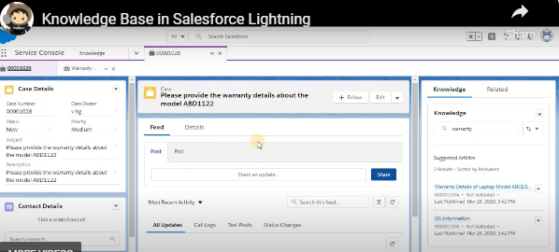
i

Slide 6
Features of Einstein Search in Salesforce
Personalized Search Results
Delivers results tailored to the user's preferences and activity.
Natural Language Search
Allows users to search using conversational language, making queries more intuitive.
Einstein Article Recommendations
Suggests relevant knowledge articles based on search queries and user behavior.
Boosted Search Results
Prioritizes the most relevant results based on user history and organizational needs.
Voice Search Capabilities
Enables searching through voice commands for hands-free operation.
Instant, Smart Suggestions
Provides real-time, intelligent search suggestions as you type.

Slide 7
Thank you
Pavithra V
5018172036
pveeramani@penserv.com

